Slide 1
Python Course for Physicists (And everyone else!) Chunk 3: Logic Operators and If-Statements
By Jonathan Bollig
08.10.2025

Slide 2
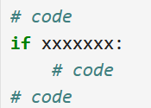
Program Flow:
Code
Execute a part of code, only when Condition is true
if - Condition
True
False
Code
Code

Slide 3
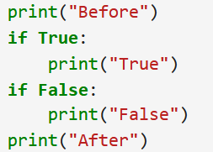

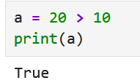
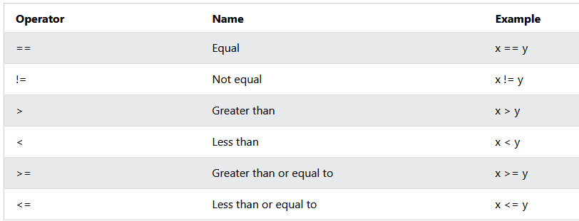
The Condition – Comparison Operators
We need a Boolean Condition: True or False
Comparison Operator True or False
True or False
[https://www.w3schools.com/python/gloss_python_comparison_operators.asp]

Slide 4
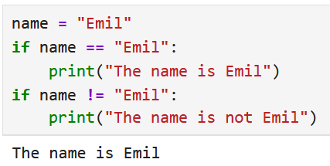
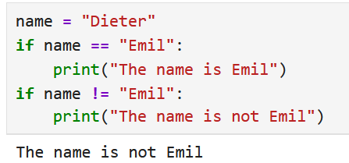
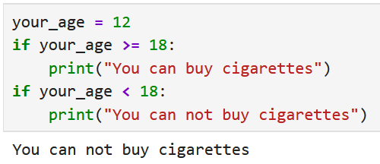
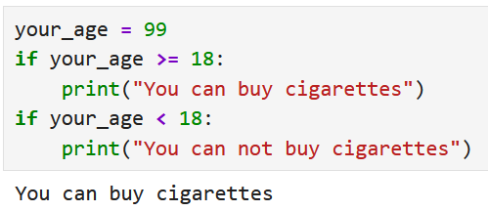
Live Coding: Examples

Slide 5
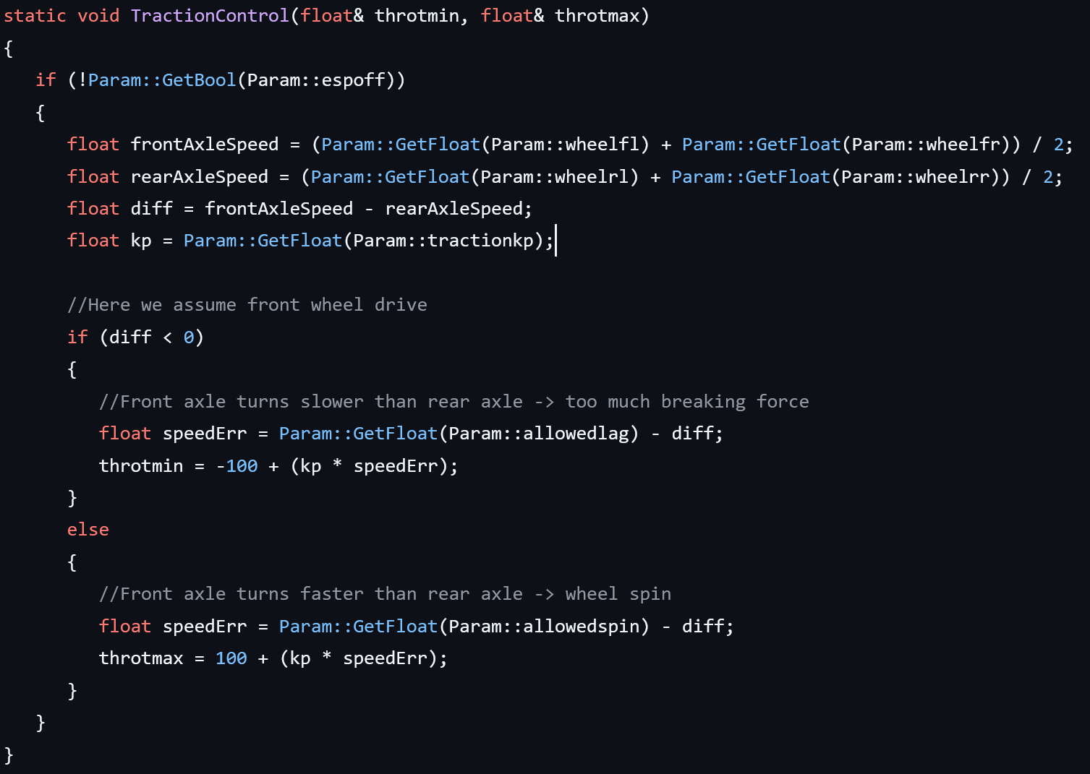
Anecdote: Traction Control
Notes:
Saturday I was procrastinating from preparing this course, by doing research on “car control software”,
and I found the following. Eventhough it’s not

Slide 6
Logical Operators: and / or / not
“not a” → True if a is False
“a and b” → True if a and b are True
“a or b” → True if a or b (or both) are True
Presedence: Order of execution. From First to Last:
not
and
or
"a and b or not c“ → "a and b or (not c)“ → "(a and b) or (not c)“

Slide 7
else - Statement
Code
Code
if - Condition
if - Condition
True
False
True
False
Code
Code
Code
Code
Code

Slide 8
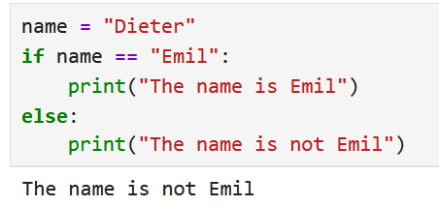
else - Statement
Code
if - Condition
False
True
=
Code
Code
Code

Slide 9
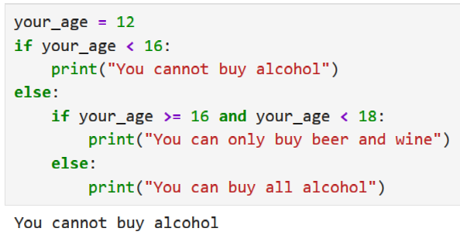
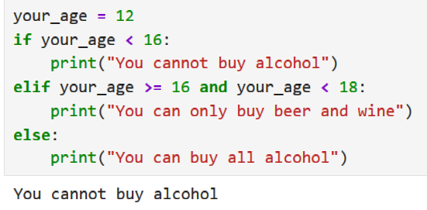
elif - Statement
Code
if - Condition
Not super important for now
False
True
elif - Condition
Code
=
True
False
Code
Code

Slide 10
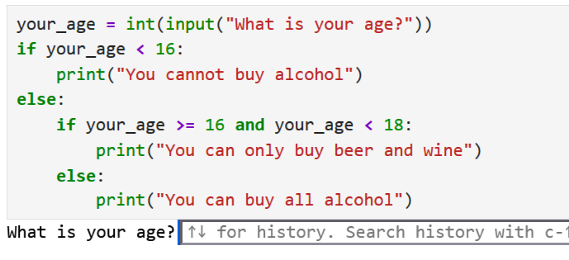
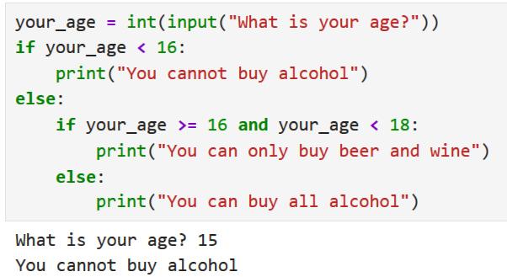
Extra: User Input
“input” let’s the program ask you for an input:
→ Generates a string!

Slide 11
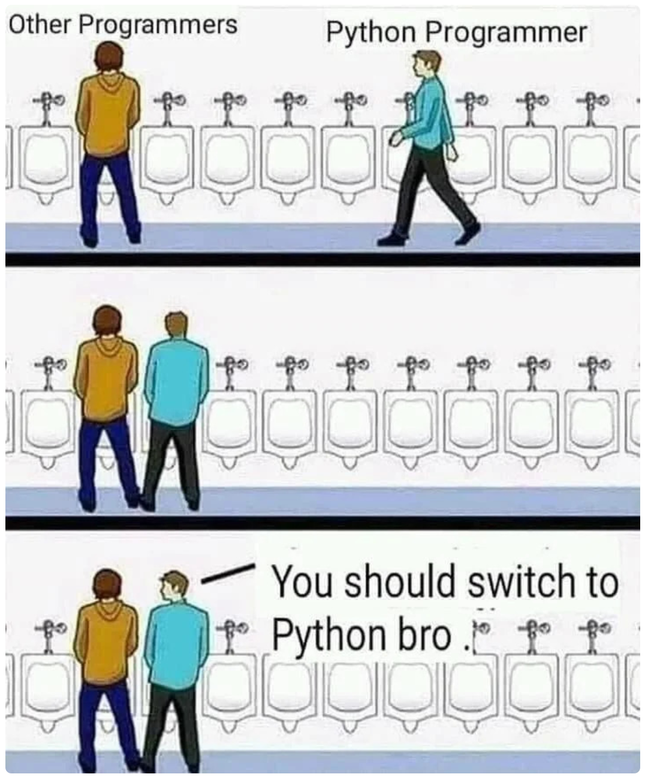
Good Luck with your Tasks ☺
[https://dev.to/codeitbro/15-funniest-and-hilarious-python-coding-memes-2aij]

